Slide 1
Mind in Motion
Machine Learning for Depression Classification using Motor Actigraphy Data
Final Presentation Gary Kong, Julia Kauffman, Leo Le, Vishnu Paty, Melia Soque

Slide 2
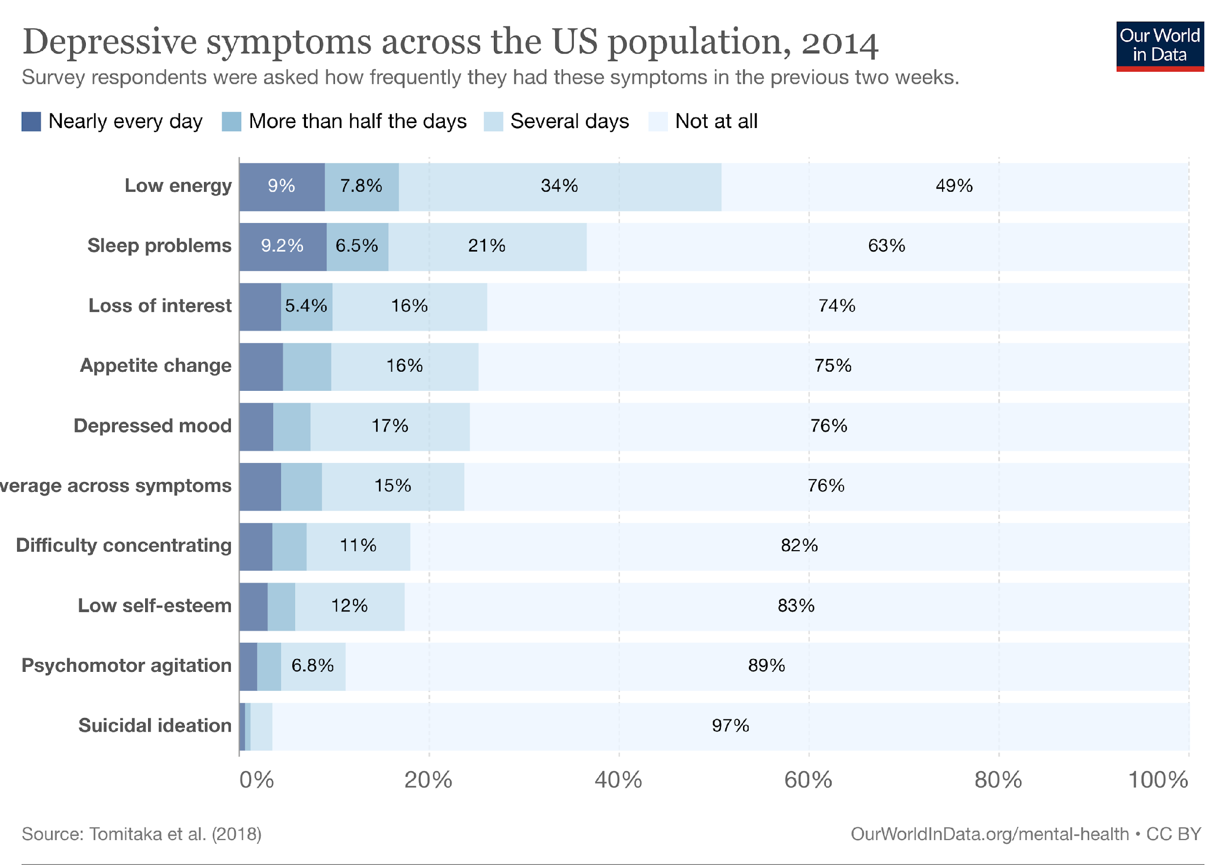
Motivation
Depression
World’s leading cause of disability
Associated with disrupted biological rhythms and changes in motor activity
Subjective diagnosis (DSM-5 criteria)
Motor actigraphy data
Non-invasive
Available through wearables (e.g., Fitbit)
Potentially objective method of diagnosing depression
Research question
Can machine learning algorithms be used to accurately classify patients into depression status (normal, mild and moderate) using motor actigraphy data?
RELATED TO
MOTOR ACTIVITY
Sources: UpToDate, WHO, Our World in Data
Notes:
Time: 45 seconds
Hello everyone,
Today's focus is on depression, a major global concern and leading cause of disability. The World Health Organization states that 5% of adults globally face depression. This means 1 in 3 women and 1 in 5 men will experience it in their lives.
Diagnosis has traditionally depended on DSM-5 criteria, leading to varied results. But with wearable tech advancements, we can track rest and activity using motor actigraphy. This offers an objective method to identify key depression symptoms, like low energy and sleep issues, as shown on the chart to your left.
Our key question: Can machine learning effectively use this data to classify patients into the correct depression status?

Slide 3
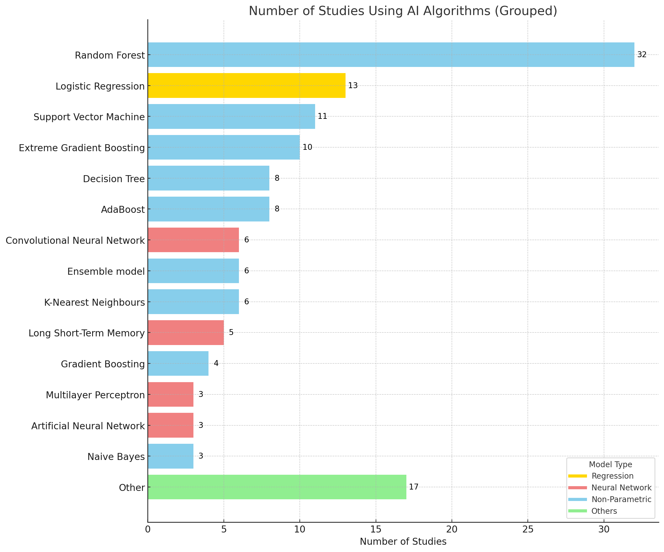
Past Studies
54 studies used AI with wearables for depression
Non-parametric methods were predominant
AI accuracy: 70-89%
AdaBoost excelled in performance, whereas logistic regression and decision trees were less effective
Source: Abd-Alrazaq, A., AlSaad, R., Shuweihdi, F. et al. (2023). Systematic review and meta-analysis of performance of wearable artificial intelligence in detecting and predicting depression. npj Digital Medicine, 6, 84. DOI: 10.1038/s41746-023-00828-5
Notes:
Time: 45 seconds
We delved into existing literature to understand the precedence of using motor actigraphy data for depression classification.
A meta-analysis by Alrazaq and team assessed 54 studies that employed AI with wearable data for detecting depression.
From this review, we noted:
As you can see in the chart on the right, past studies have used non-parametric methods (shown in blue), logistic regression (shown in yellow), and neural networks (shown in red), with non-parametric methods dominating
Across studies, AI demonstrated an accuracy range of 70-89% in classifying patients
Algorithm-wise, AdaBoost was often the top performer, while logistic regression and decision trees lagged behind

Slide 4
Data Overview
Data Source
Depresjon: A Motor Activity Database of Depression Episodes in Unipolar and Bipolar Patients
Count of Patients by MADRS Group
OUTCOME VARIABLE
Summary Statistics
Variable | Values | Count | %
Gender | Female | 30 | 55%
 | Male | 25 | 45%
Affective Type | Normal | 32 | 58%
 | Unipolar | 15 | 27%
 | Bipolar | 8 | 15%
Days of Observation | Mean | 13 days
Age | Mean | 40 years
Education | Mean | 11 years
Class imbalance
NORMAL PATIENTS
DEPRESSED PATIENTS
Source: Enrique Garcia-Ceja, Michael Riegler, Petter Jakobsen, Jim Tørresen, Tine Nordgreen, Ketil J. Oedegaard, Ole Bernt Fasmer. "Depresjon: A Motor Activity Database of Depression Episodes in Unipolar and Bipolar Patients." Proceedings of the 9th ACM on Multimedia Systems Conference (MMSys'18), 2018. DOI: 10.1145/3204949.3208125
Notes:
Time: 1 minute
Let's recap the data we've worked with.
We've used the Depresjon motor actigraphy dataset. This was gathered using an actigraph watch worn on the right wrist of patients, capturing activity every minute.
Our outcome variable was based on the MADRS2 score which we used to group patients into three categories: normal, mild, and moderately depressed. This score reflects depression levels at the end of each observation. A unique aspect of our study which sets it apart from much of the existing literature is how we differentiate between mild and moderate depression.
Regarding our dataset size and composition:
We had a total of 55 patients.
As shown on the chart to your left, there's a notable class imbalance among the three categories. Julia will address how we address this later on..
On the right, you'll observe a skew towards female participants, mirroring the higher depression prevalence in females. Amongst those with depression, unipolar cases outweigh bipolar ones.
On average, we have 13 days of data for each patient, who typically are around 40 years old with 11 years of education

Slide 5
Approach
Ingestion
Depresjon Datasets
Preparation
Data Wrangling/Cleaning
Feature Engineering
Data Augmentation
Logistic Regression
Model Development
Model Selections
Data Splitting
Standard K-Fold Validation
Hyper-parameters tuning
Evaluation Metrics
AdaBoost
XGBoost
LSTM
Grid
Search
Ablation Study
Deep Neural Network
Baseline Accuracy : 33.33%
Notes:
target: 60 seconds
As Gary mentioned, we used Depresjon Datasets as our data source. These data are csv files so ingesting is pretty straight forwards. After that, we are ready to prepare data by first cleaning/wrangling raw data which means looking for inconsistencies, outliers and standardizing the data to the format that we want. We then use the clean data to perform feature engineering, choosing important metrics and approaches of how we want to run our data structure in machine learning algorithm. After defining our features and data structure, we notice the very limited number of data points we have (about 54 data points), so we have to augment our data to provide more quality samples. The next step after having clean, consistent sufficient data is to develop our model. In our research, we ran 5 models (list models) to see which will bring us the best results. Due to the lack of data, for each of our models, we utilized standard K-Fold Validation to split our data into more subsets of data for testing. Finally, we performed hyper-parameters tunning using evaluation metrics as our benchmarks loop feedback. Moreover, because we are predicting 3 classes, our baseline accuracy is 33.33% split between each class. And in this presentations, we will be talking in depth about our logistic regression, LSTM and deep neural network models

Slide 6
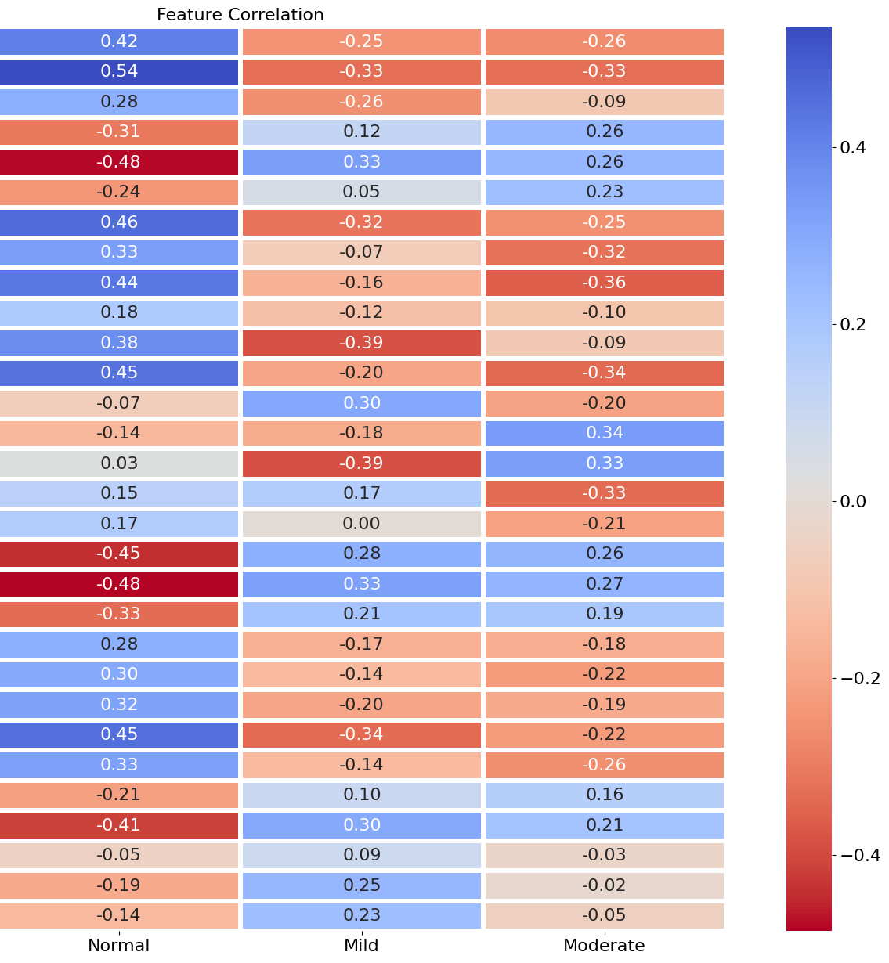
Feature Engineering
Feature Extraction
Feature Selection
Top 30 Features
57 Features
Activity Entropy (by Hour)
Activity Entropy (by Minute)
Activity Intraday Variability
Activity Kurtosis (by Day)
Activity Kurtosis (by Hour)
Activity Kurtosis (by Minute)
Activity Mean (Overall)
Activity Mean (Weekdays, 00:00 - 06:00)
Activity Mean (Weekdays, 06:00 - 12:00)
Activity Mean (Weekends, 12:00 – 18:00)
Activity Mean (Weekends, 12:00 – 18:00)
Activity Mean (Weekends, 06:00 – 12:00)
% Activity (00:00 – 06:00)
% Activity (12:00 – 18:00)
% Activity (18:00 – 00:00)
% Activity (06:00 – 12:00)
% Activity (Weekdays)
Activity Skewness (by Day)
Activity Skewness (by Hour)
Activity Skewness (by Minute)
Activity Standard Deviation (by Hour)
Active Bout Duration Standard Kurtosis
Active Bout Duration Standard Deviation
Number of Active Bouts
Inactive Bout Duration Coef. of Variation
Inactive Bout Duration Entropy
Inactive Bout Duration Mean
Inactive Bout Duration Standard Deviation
Cosine Amplitude (by Day of Week)
Cosine Phase (by Minute of Day)
Activity distribution
metrics
Greedy feature selection (correlation-based) score
Activity proportions by time of day / week
Decision-tree feature importance score
Active / inactive bout metrics
Composite feature importance score
Cosine parameters
Rank of feature importance
Notes:
Time: 2 minutes
Now I’d like to talk about feature engineering.
We started with minute-by-minute activity for each patient. From there, we extracted 57 features spread over four main categories:
First, we looked at statistical metrics that summarize patients’ distribution of activity. This includes metrics like mean, kurtosis, standard deviation, and intraday variability, which we calculated at different levels of aggregation of the time series data
Second, we analyzed how activity is distributed across a day and a week. The hypothesis here is that patients in the different classes have different proportions of activity occurring at different times of the day or week.
Third, we calculated features based on bouts of activity and inactivity to identify patterns of behavior such as sedentary behavior or restlessness
Finally, because activity patterns are cyclical, we fitted cosine equations and derive parameters such as amplitude, phase and frequency at different levels of aggregation. This was an addition we made since our baseline presentation
Since our baseline presentation, we also applied feature selection techniques
We used a greedy feature selection algorithm where we selected features with the highest correlation to the depression classes, removed features that were highly correlated with the selected features, and iterated through this process
We also used sklearn’s decision tree algorithm to calculate feature importance scores
We calculated a composite score, which we used to rank features and select the top 30
The chart to your right displays the top 30 features, highlighting their correlations with depression classes
You can see through the color coding that features across all four categories were included, suggesting each category captures a different aspect of behavior
Also, there appears to be a distinct signature for each of the three classes, suggesting that the features should be able to distinguish between each class
I’ll hand over to Julia to talk about data augmentation

Slide 7
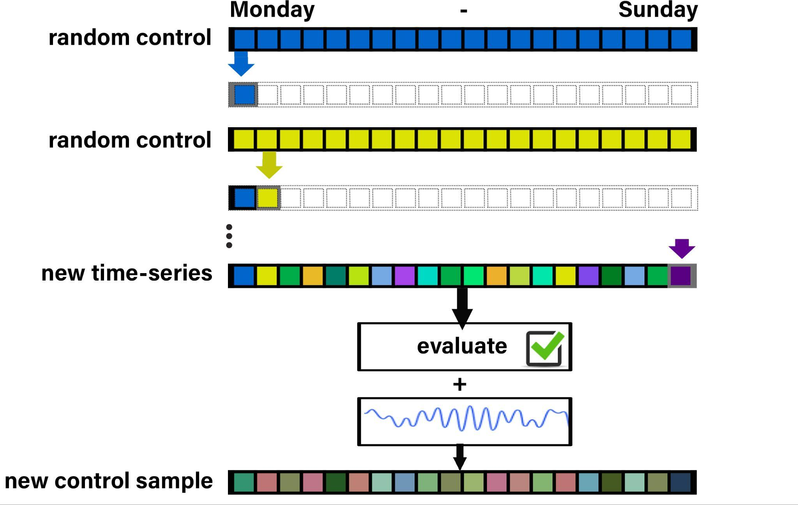
Data Augmentation via Cross-Subject Data Fusion
Process Overview
Randomly select sample
Time-segment slicing
Repeat - incorporating slices from different random subjects
Assess the quality
Add noise
 | Control | Mild | Moderate
Before | 23 | 11 | 12
After | 40 | 40 | 40
Notes:
target: 45 seconds
Data Augmentation via Cross-Subject Fusion: A Process Overview
1. Initial Sample Selection: Randomly select an initial sample from the dataset.
2. Time-Segment Slicing: Slice off a segment of time from the chosen sample.
3. Secondary Sample Selection: Randomly select another sample from the dataset.
4. Additional Time-Segment Slicing: Slice off a time-segment from the secondary sample.
5. Segment Composition: Repeat steps 2-4 iteratively until a complete time-sample is formed, incorporating slices from different subjects.
6. Generated Sample Evaluation: Assess the quality and relevance of the generated sample to ensure it aligns with the intended augmentation goals.
7. Noise Addition: Introduce controlled noise to the generated sample, enhancing its variability while maintaining its authenticity.
(Note: Initially, I tried using a GANs model to synthesize data. However, due to the lengthy training time (over 12 hours), the intricate process of fine-tuning parameters for two competing models, and the model's limitations in fully capturing the nuanced complexity of lengthy time-series data, I opted for a more accessible method to perform data augmentation to ensure maintaining data integrity.)

Slide 8
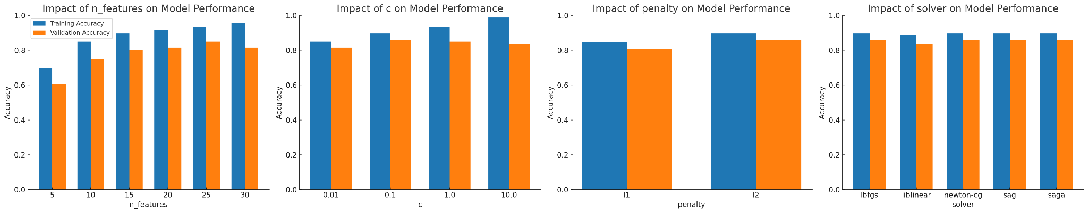
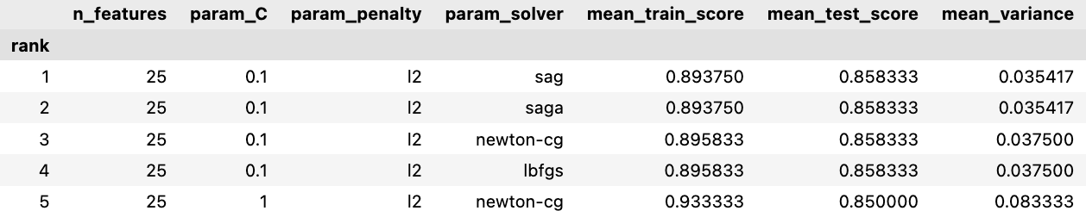
Logistic Regression
Best hyperparameter(s)
Ablation analysis suggests optimal hyperparameters are: n_features=25, c=0.1, penalty=L2, solver=sag/saga
Grid search confirms this
Grid Search Results (Sorted / Ranked by Mean Test Score)
Notes:
target: 120 seconds
**Why Logistic Regression?**
Given our dataset's characteristics, logistic regression was an ideal fit for our dataset size. We enhanced its performance through hyperparameter tuning for precise predictions."
**Methodology**: “
“For the hyperparameter tuning we took two approaches: “
On the left are charts from the ablation analysis, displaying training and validation accuracy scores, derived from the k-fold cross validation Leo previously discussed
Our criteria for the best hyperparameters prioritize high validation accuracy and low variance
we altered 1 hyperparameter at a time with a total of 4.
Number of Features: We studied subsets from the initial 5 up to all 30 features to determine the optimal feature set and prevent potential overfitting. With an increase from 5 to 15 features, both training and validation accuracies improved. Beyond the 15 features, training accuracy peaked at 30, but validation stagnated, indicating the optimal set to be the first 25 features with a 3.5% variance.
C (Inverse of Regularization Strength): is a vital hyperparameter. Smaller values aim for simpler patterns to avoid overfitting. Given the variance observed as C increases from 0.01 to 10, Our findings suggested a C of 0.1 is ideal,
Penalty: We favored the l2 (Ridge regression) technique, which adjusts but retains feature coefficients, while preventing overfitting.
Solver: From the various solvers depicted in the graph, our model consistently performed well with SAG and SAGA, underscoring their optimization and rapid convergence advantages."
**5. Grid Search Results**:
“And then with the grid search cross validation, we implemented it to make sure we didnt miss a set of hyperparameters from the ablation. The table on the right shows the best 5 hyperparameters. Both the ablation study and grid search pinpointing the same optimal hyperparameters indicates a strong agreement and lends additional validation to our modeling choices.
Accuracy with best hyper parameters -With the optimal hyperparameters, our model achieved 89.4% training accuracy and 86% validation accuracy, demonstrating reliable predictions and good generalization.
---Thank you for your attention, and now, I'll pass it on to Claira.

Slide 9
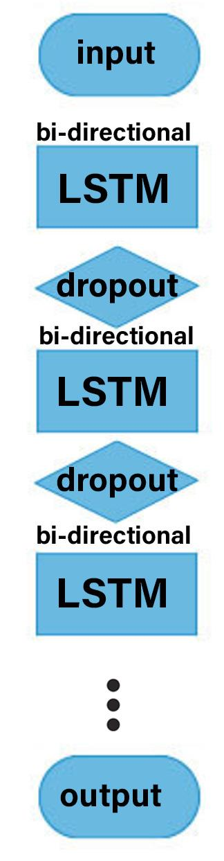
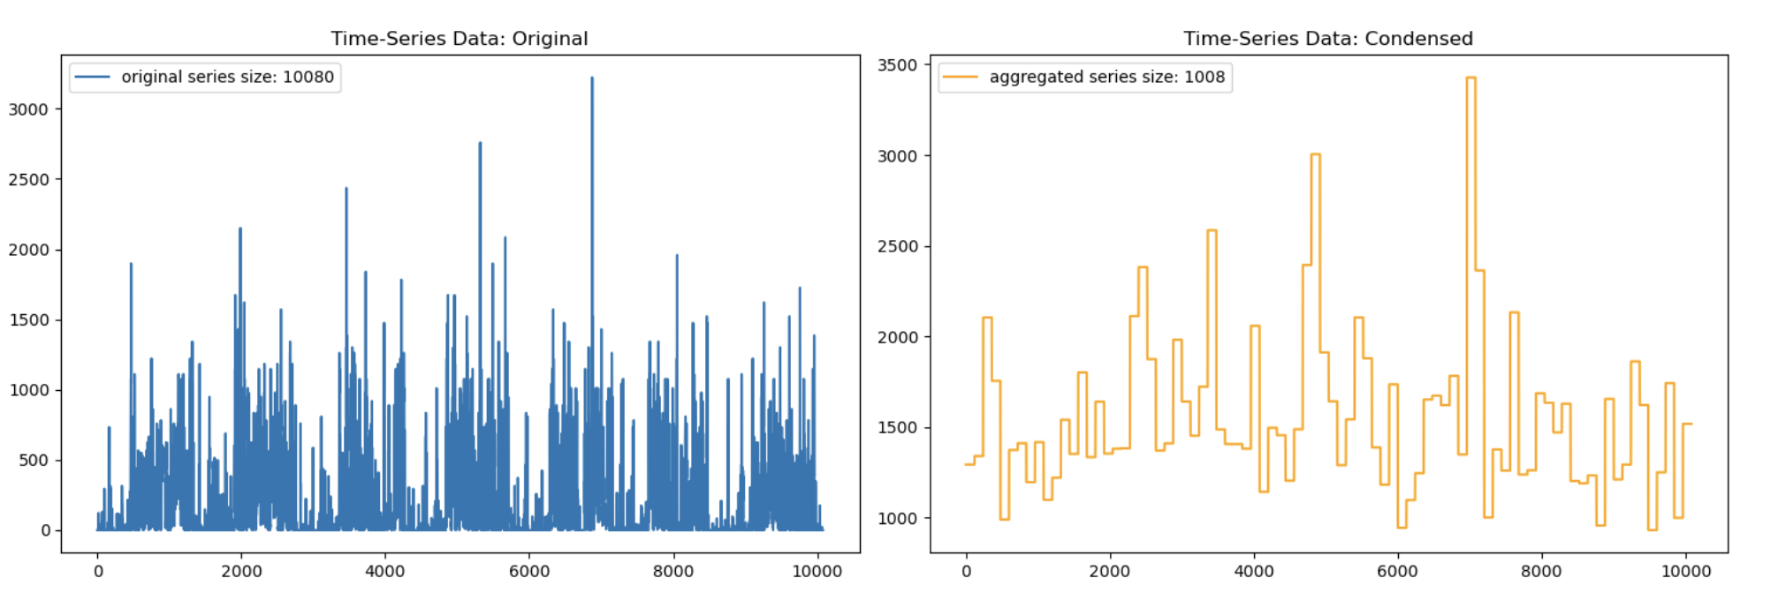
LSTM Recurrent Neural Network
Using only time-series readings
Note: Refer to the notebook at https://github.com/UC-Berkeley-I-School/mids-207-final-project-summer23-Kong-Kauffmann-Soque-Le-Paty/blob/main/notebooks/w207_2_models_and_evaluation.ipynb
for hyperparameter tuning and model results
Notes:
target: 60 seconds
1. RNN with LSTM Layers:
- Used bi-directional LSTM layers to detect time-series’ patterns in both directions.
- Preprocessed data by normalizing and making samples uniform in length.
- Original time-series length: 10080 (1-minute readings for a week).
- Condensed data by selecting maximum value every 10 minutes (since peak activity is telling), reducing to 1008 samples.
- Added more LSTM layers than suggested (3), leading to a 5-10% performance boost, but at a cost.
- Render time was a limiting factor for testing various parameters.
- Achieved an average accuracy of around 65%, exceeding the 33% baseline.
2. Combination of LSTM and Dense Layers:
- Attempted a hybrid model with LSTM and dense layers.
- Aiming to capture both sequential patterns and higher-level abstractions.
- No significant improvement observed.

Slide 10
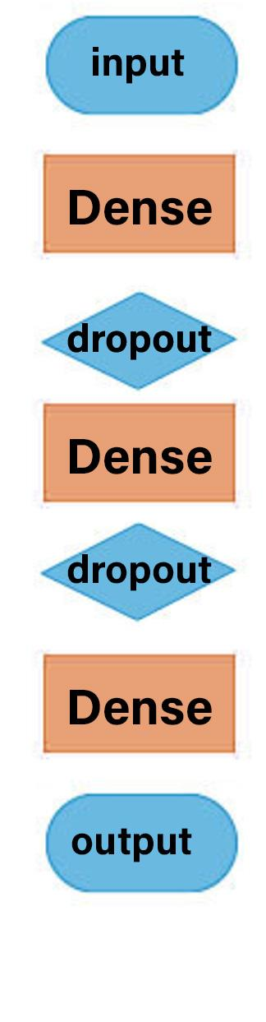
Dense Neural Network
Using selected extracted features
Model performs on par with our best models:
Accuracy 82.5%
Precision 85.1%
Recall 80.0%
F1-Score 82.4%
Note: Refer to the notebook at https://github.com/UC-Berkeley-I-School/mids-207-final-project-summer23-Kong-Kauffmann-Soque-Le-Paty/blob/main/notebooks/w207_2_models_and_evaluation.ipynb
for hyperparameter tuning and model results
Notes:
target: 30 seconds
Deep Neural Network (DNN) with Dense Layers:
- Employed a DNN architecture using only dense layers on extracted selected features.
- Used ablation analysis to optimize
- Experimented with different number of input features
- Achieved an accuracy of approximately 82%, comparable to the best model's performance.

Slide 11
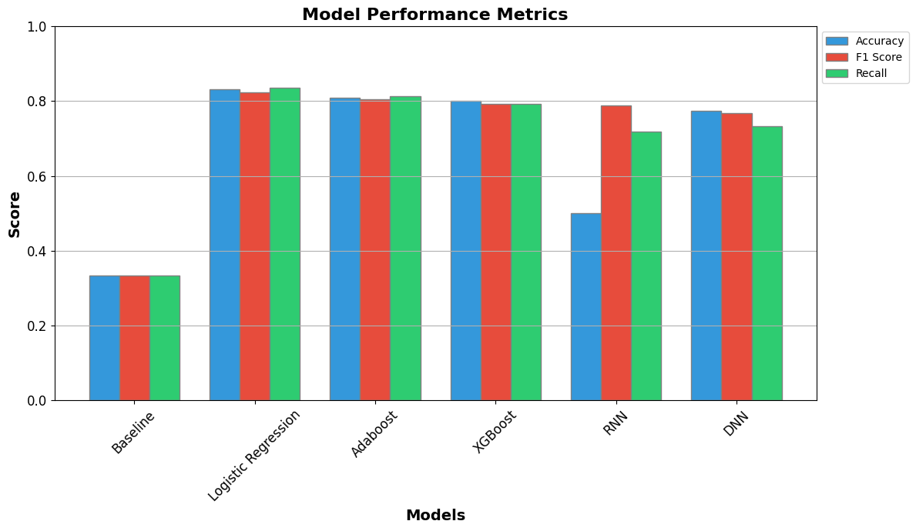
Evaluation
Statistical tests:
ANOVA
Post-hoc pairwise comparisons with Bonferroni correction
Logistic regression significantly outperforms other models
85.83% accuracy
85.74% F1 score
87.8% recall
Lowest variance
Sometimes the simplest model is best!
Notes:
target: 60 seconds
As we can see, all of our models improved above the baseline of 33.33% accuracy and topped out at above 85% accuracy, which is pretty exciting as it puts us quite favorably compared to other similar studies that have been done in the space. For most of our models, recall, f1 score, and accuracy reached similar values, indicating that our data augmentation approach did a decent job at balancing the classes.
We used ANOVA as an omnibus test and then conducted post-hoc pairwise comparisons to determine if our models were significantly different from each other.
And so we discovered that after using ablation analysis and grid search to optimize hyperparameters, Logistic Regression significantly outperforms our other models in accuracy, f1 score, recall, and variance. In other words, it does the best job at classifying depression status, balancing false positives and negatives, minimizing false negatives, and overfits less than the other models, including the two neural networks tested. And after analyzing the confusion matrix, it also performs similarly at correctly classifying each class. And so these are all really beneficial and important traits, particularly the high recall we observed at 87.8%. Overall, we would recommend Logistic Regression as a simpler and fast approach to classifying depression status using motion actigraph data, and we were pretty surprised that our most simple model performed the best. We do think that larger datasets that include detailed demographic features may change this recommendation to favor more complex approaches, particularly neural networks. But we think this is a really good start, and really highlighted to us the importance of hyperparameter tuning.

Slide 12
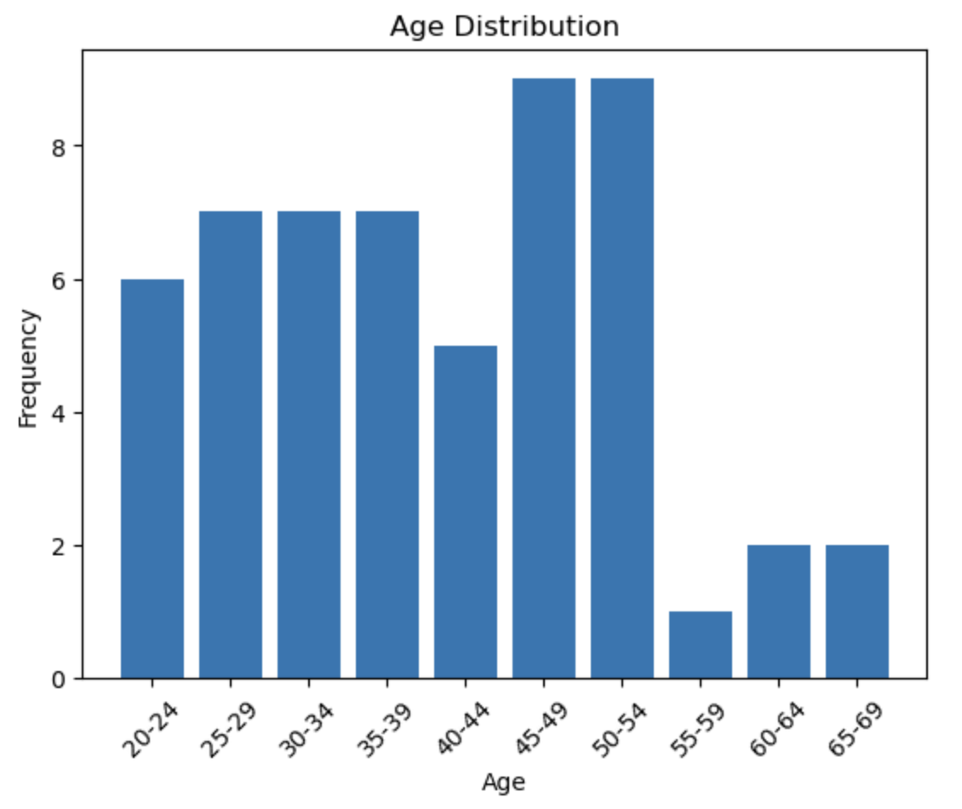
Limitations
Biases
Small Sample Size
Unrepresentative Control Group
Unbalanced Age Group
Time Period Sampling
MADRS Score Variability
Demographic Balance
Urban vs. Rural Disparity
Accessibility Generalization
Time Period Sampling
Observer Effect and Compliance
Notes:
LIMITATIONS:
1. Small Sample Size: The dataset's limited size may hinder the generalizability of findings and the ability to detect subtle trends.
2. Unrepresentative Control Group: The control group's composition of students and hospital employees could introduce activity-related bias.
3. Unbalanced Age Groups: The distribution of participants across age groups might skew the results and impact the ability to draw comprehensive conclusions.
4. Time Period Sampling: Activity readings of participants taken during different times of the year
5. MADRS Score Variability: Variability in scores over the measurement time could introduce noise
!!!!!no severe depression
BIASES:
1. Demographic Balance: While gender is roughly balanced, the absence of racial demographics might introduce biases
2. Urban vs. Rural Disparity: Lack of information about participants' urban or rural backgrounds could introduce biases related to activity levels
3. Accessibility Generalization: Might overlook individuals with disabilities, particularly those who use wheelchairs or who have mobility issues.
4. Observer Effect and Compliance: Participants' awareness of being recorded might lead to altered behaviors

Slide 13
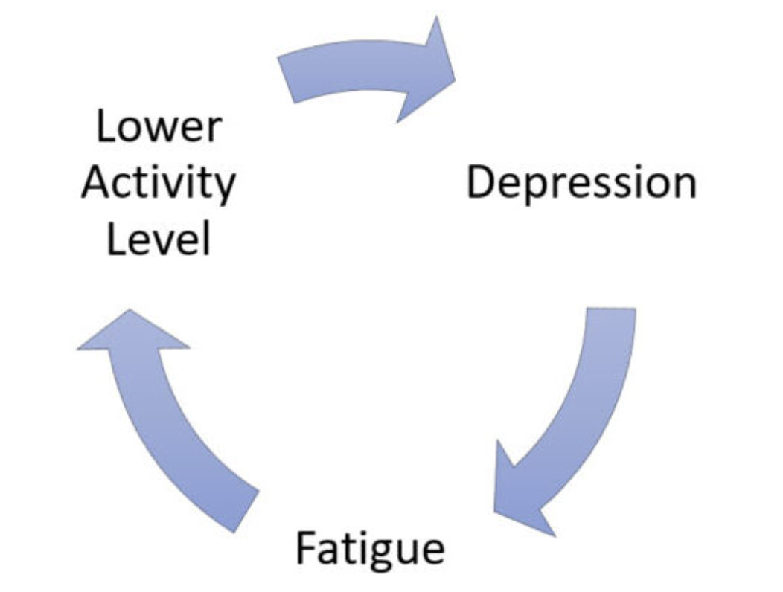
Conclusions
Next Steps:
Expand the Dataset
Decide on model: DNN?
Further fine-tune parameters
Collaborate with mental health professionals
Address ethical considerations
Develop user-friendly tools
Notes:
Next steps could include:
Expand the Dataset Size and Demographic Representation: Explore larger datasets to improve the generalizability.
Decide on a model: While the Deep Neural Network didn't emerge as our top-performing model, we believe that with a larger sample size and additional demographic data, it has the potential to capture more intricate interaction with activity.
Collaborate with Mental Health Professionals: Work closely to implement in real-world scenarios.
Address Ethical Considerations: Consider ethical implications in the model application.
Develop User-Friendly Tools: Create applications or tools that can be easily used for monitoring of depression.
Despite our concerns regarding data generalizability and potential biases, the evidence sufficiently justifies further research into leveraging the power of machine learning on activity data. This could ultimately lead to enhanced and more readily accessible mental health support.

Slide 14
Contributions
 | Gary Kong | Julia Kauffman | Leo Le | Vishnu Paty | Melia Soque
Literature Search | X | X | X | X | X
Data Wrangling and Cleaning | X
Feature Extraction and Feature Selection | X
Data Augmentation |  | X
Data Splitting and Cross-validation |  | X | X | X | X
Model Development and Hyperparameter Tuning | Logistic regression | LTSM Deep neural network | AdaBoost (Lead) XGBoost (Lead) | AdaBoost (Support) XGBoost (Support) | Logistic regression
Model Evaluation |  |  |  | X

